Slide 1


Unit B:
Stacks And Queues

Slide 2
B.1
Introduction to the
Stack ADT

Slide 3
Introduction to the Stack ADT
Stack: a LIFO (last in, first out) data structure
Examples:
  plates in a cafeteria
  return addresses for function calls
Implementation:
  static: fixed size, implemented as array
  dynamic: variable size, implemented as linked list

Slide 4
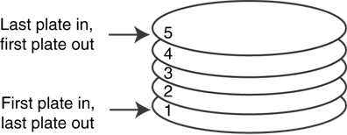
A LIFO Structure

Slide 5
Stack Operations and Functions
Operations:
  push: add a value onto the top of the stack
  pop: remove a value from the top of the stack
Functions:
  isFull: true if the stack is currently full, i.e., has no more space to hold additional elements
  isEmpty: true if the stack currently contains no elements

Slide 6
Stack Operations - Example
A stack that can hold char values:
K
E
G
K
E
E
push('E');
push('K');
push('G');

Slide 7
Stack Operations - Example
A stack that can hold char values:
E
K
E
pop();
(remove G)
pop();
(remove K)
pop();
(remove E)

Slide 8
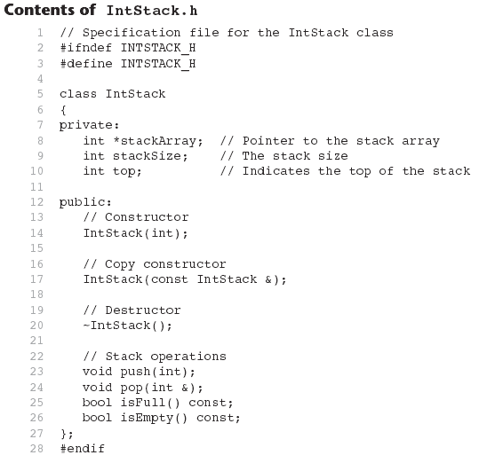

Slide 9
B.2
Dynamic Stacks

Slide 10
Dynamic Stacks
Grow and shrink as necessary
Can't ever be full as long as memory is available
Implemented as a linked list

Slide 11
B.3
Introduction to the Queue ADT

Slide 12
Introduction to the Queue ADT
Queue: a FIFO (first in, first out) data structure.
Examples:
  people in line at the theatre box office
  print jobs sent to a printer
Implementation:
  static: fixed size, implemented as array
  dynamic: variable size, implemented as linked list

Slide 13
Queue Locations and Operations
rear: position where elements are added
front: position from which elements are removed
enqueue: add an element to the rear of the queue
dequeue: remove an element from the front of a queue

Slide 14
Queue Operations - Example
A currently empty queue that can hold char values:
enqueue('E');
front
E
rear

Slide 15
Queue Operations - Example
enqueue('K');
enqueue('G');
front
E | K
rear
front
E | K | G
rear

Slide 16
Queue Operations - Example
dequeue(); // remove E
dequeue(); // remove K
front
K | G
rear
front
G
rear

Slide 17
dequeue Issue, Solutions
When removing an element from a queue, remaining elements must shift to front
Solutions:
  Let front index move as elements are removed (works as long as rear index is not at end of array)
  Use above solution, and also let rear index "wrap around" to front of array, treating array as circular instead of linear (more complex enqueue, dequeue code)

Slide 18
Contents of IntQueue.h
1 // Specification file for the IntQueue class
2 #ifndef INTQUEUE_H
3 #define INTQUEUE_H
4
5 class IntQueue
6 {
7 private:
8 int *queueArray; // Points to the queue array
9 int queueSize; // The queue size
10 int front; // Subscript of the queue front
11 int rear; // Subscript of the queue rear
12 int numItems; // Number of items in the queue
18-<number>

Slide 19
Contents of IntQueue.h
(Continued)
13 public:
14 // Constructor
15 IntQueue(int);
16
17 // Copy constructor
18 IntQueue(const IntQueue &);
19
20 // Destructor
21 ~IntQueue();
22
23 // Queue operations
24 void enqueue(int);
25 void dequeue(int &);
26 bool isEmpty() const;
27 bool isFull() const;
28 void clear();
29 };
30 #endif

Slide 20
B.4
Dynamic Queues

Slide 21
Dynamic Queues
Like a stack, a queue can be implemented using a linked list
Allows dynamic sizing, avoids issue of shifting elements or wrapping indices
NULL
front
rear

